Slide 1
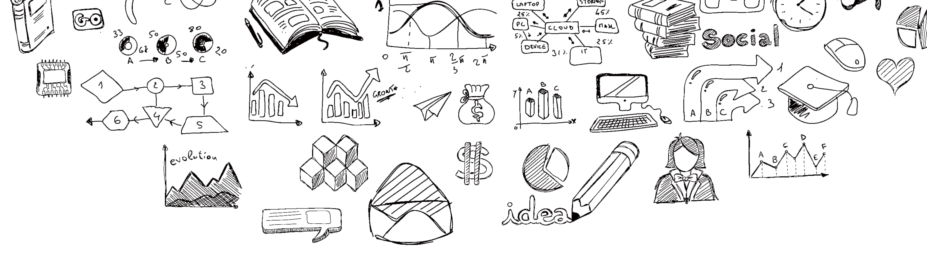
NFTChallege
Nervos
汇报团队: NFTChallenge
时间：2021-10-4

Slide 2
PART 01
Background
PART 02
NFTChallenge
Content
PART 03
NFTCollect
PART 04
Expection

Slide 3
Part
Background
NFT & Metaverse

Slide 4
NFT with Metaverse
Metaverse is a platform carrying virtual activities. Users can carry out social and spiritual activities such as social networking, entertainment, creation, education and trading. Metaverse is definitely not only a large entertainment platform, but also the upgrading and iteration of Internet life.
NFT can become the entity of metaverse power. Programs can confirm the user's authority by identifying NFT. In the future, NFT can become a token for confirming the right in the information world, which will realize the decentralized transfer of power in the virtual world

Slide 5

Part
NFTChallege
A platform to make NFT more valuable

Slide 6
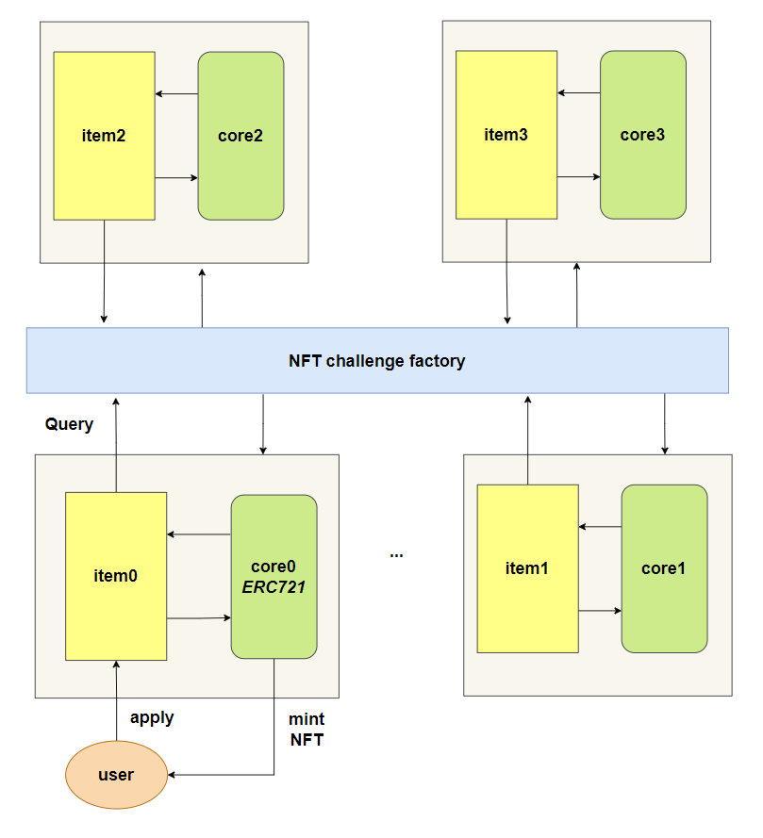
NFT challenge overview

Slide 7
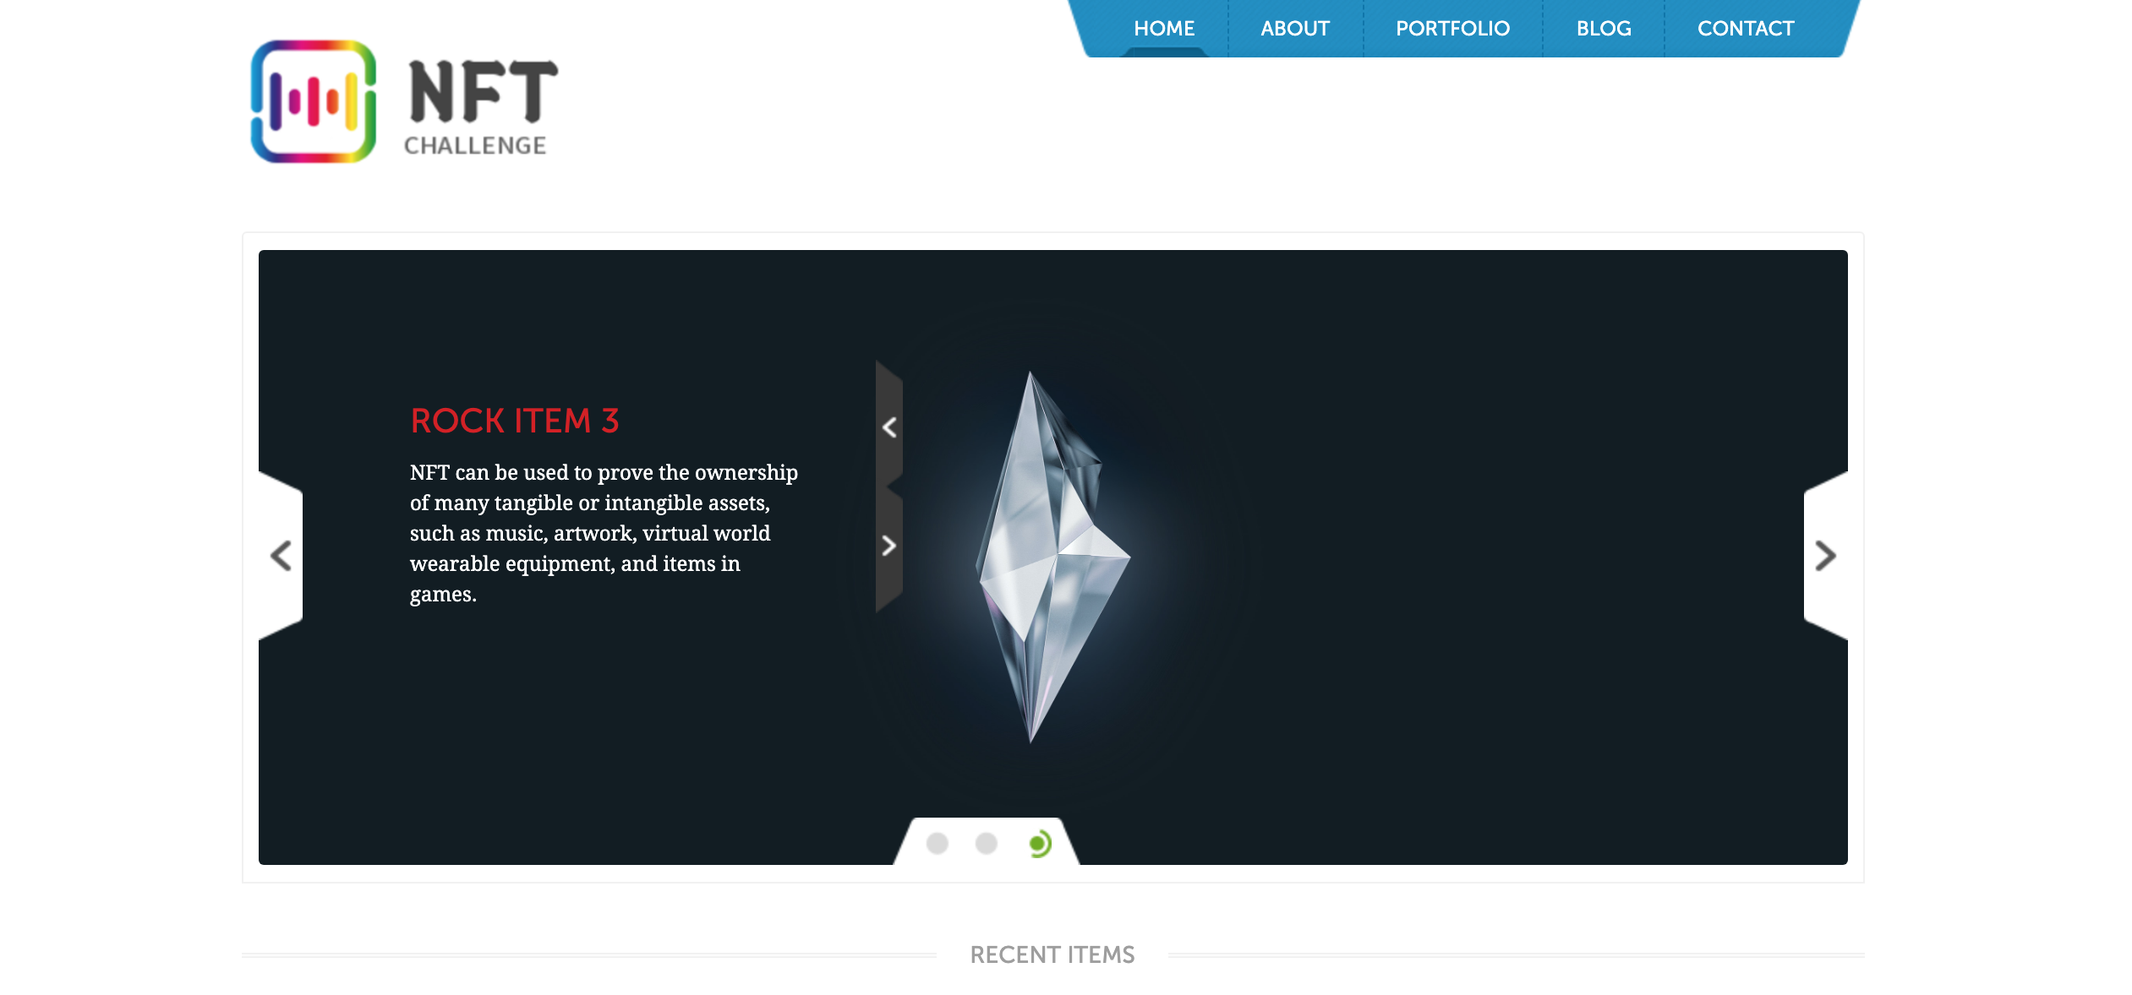
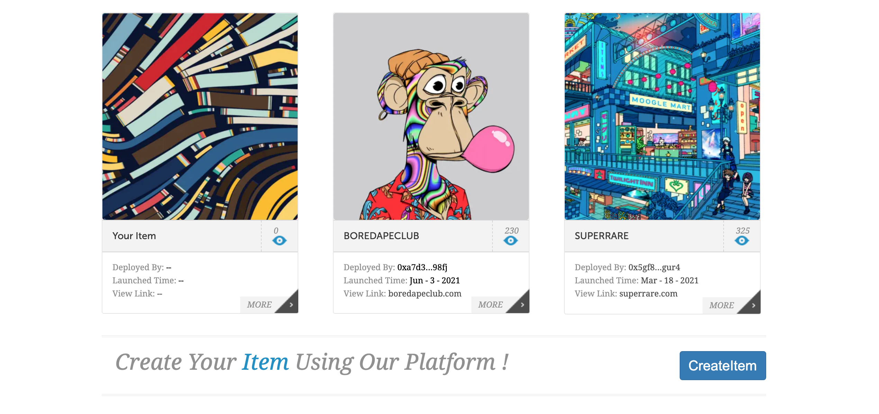
NFT challenge front_end

Slide 8
Part
CollectNFT
An interesting example in the plantform
行业PPT模板http://www.1ppt.com/hangye/

Slide 9
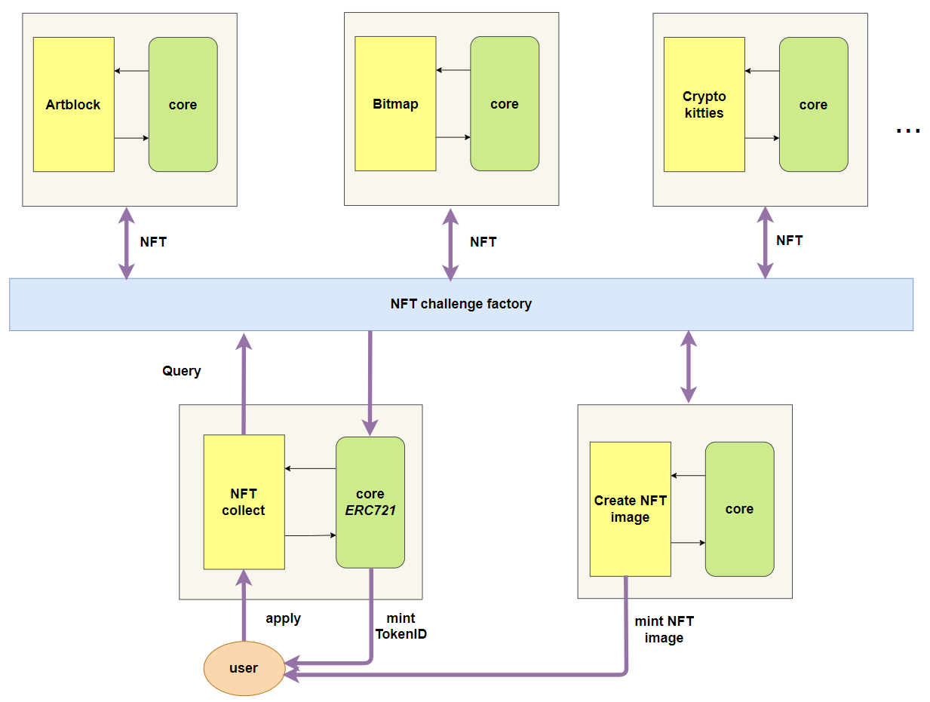
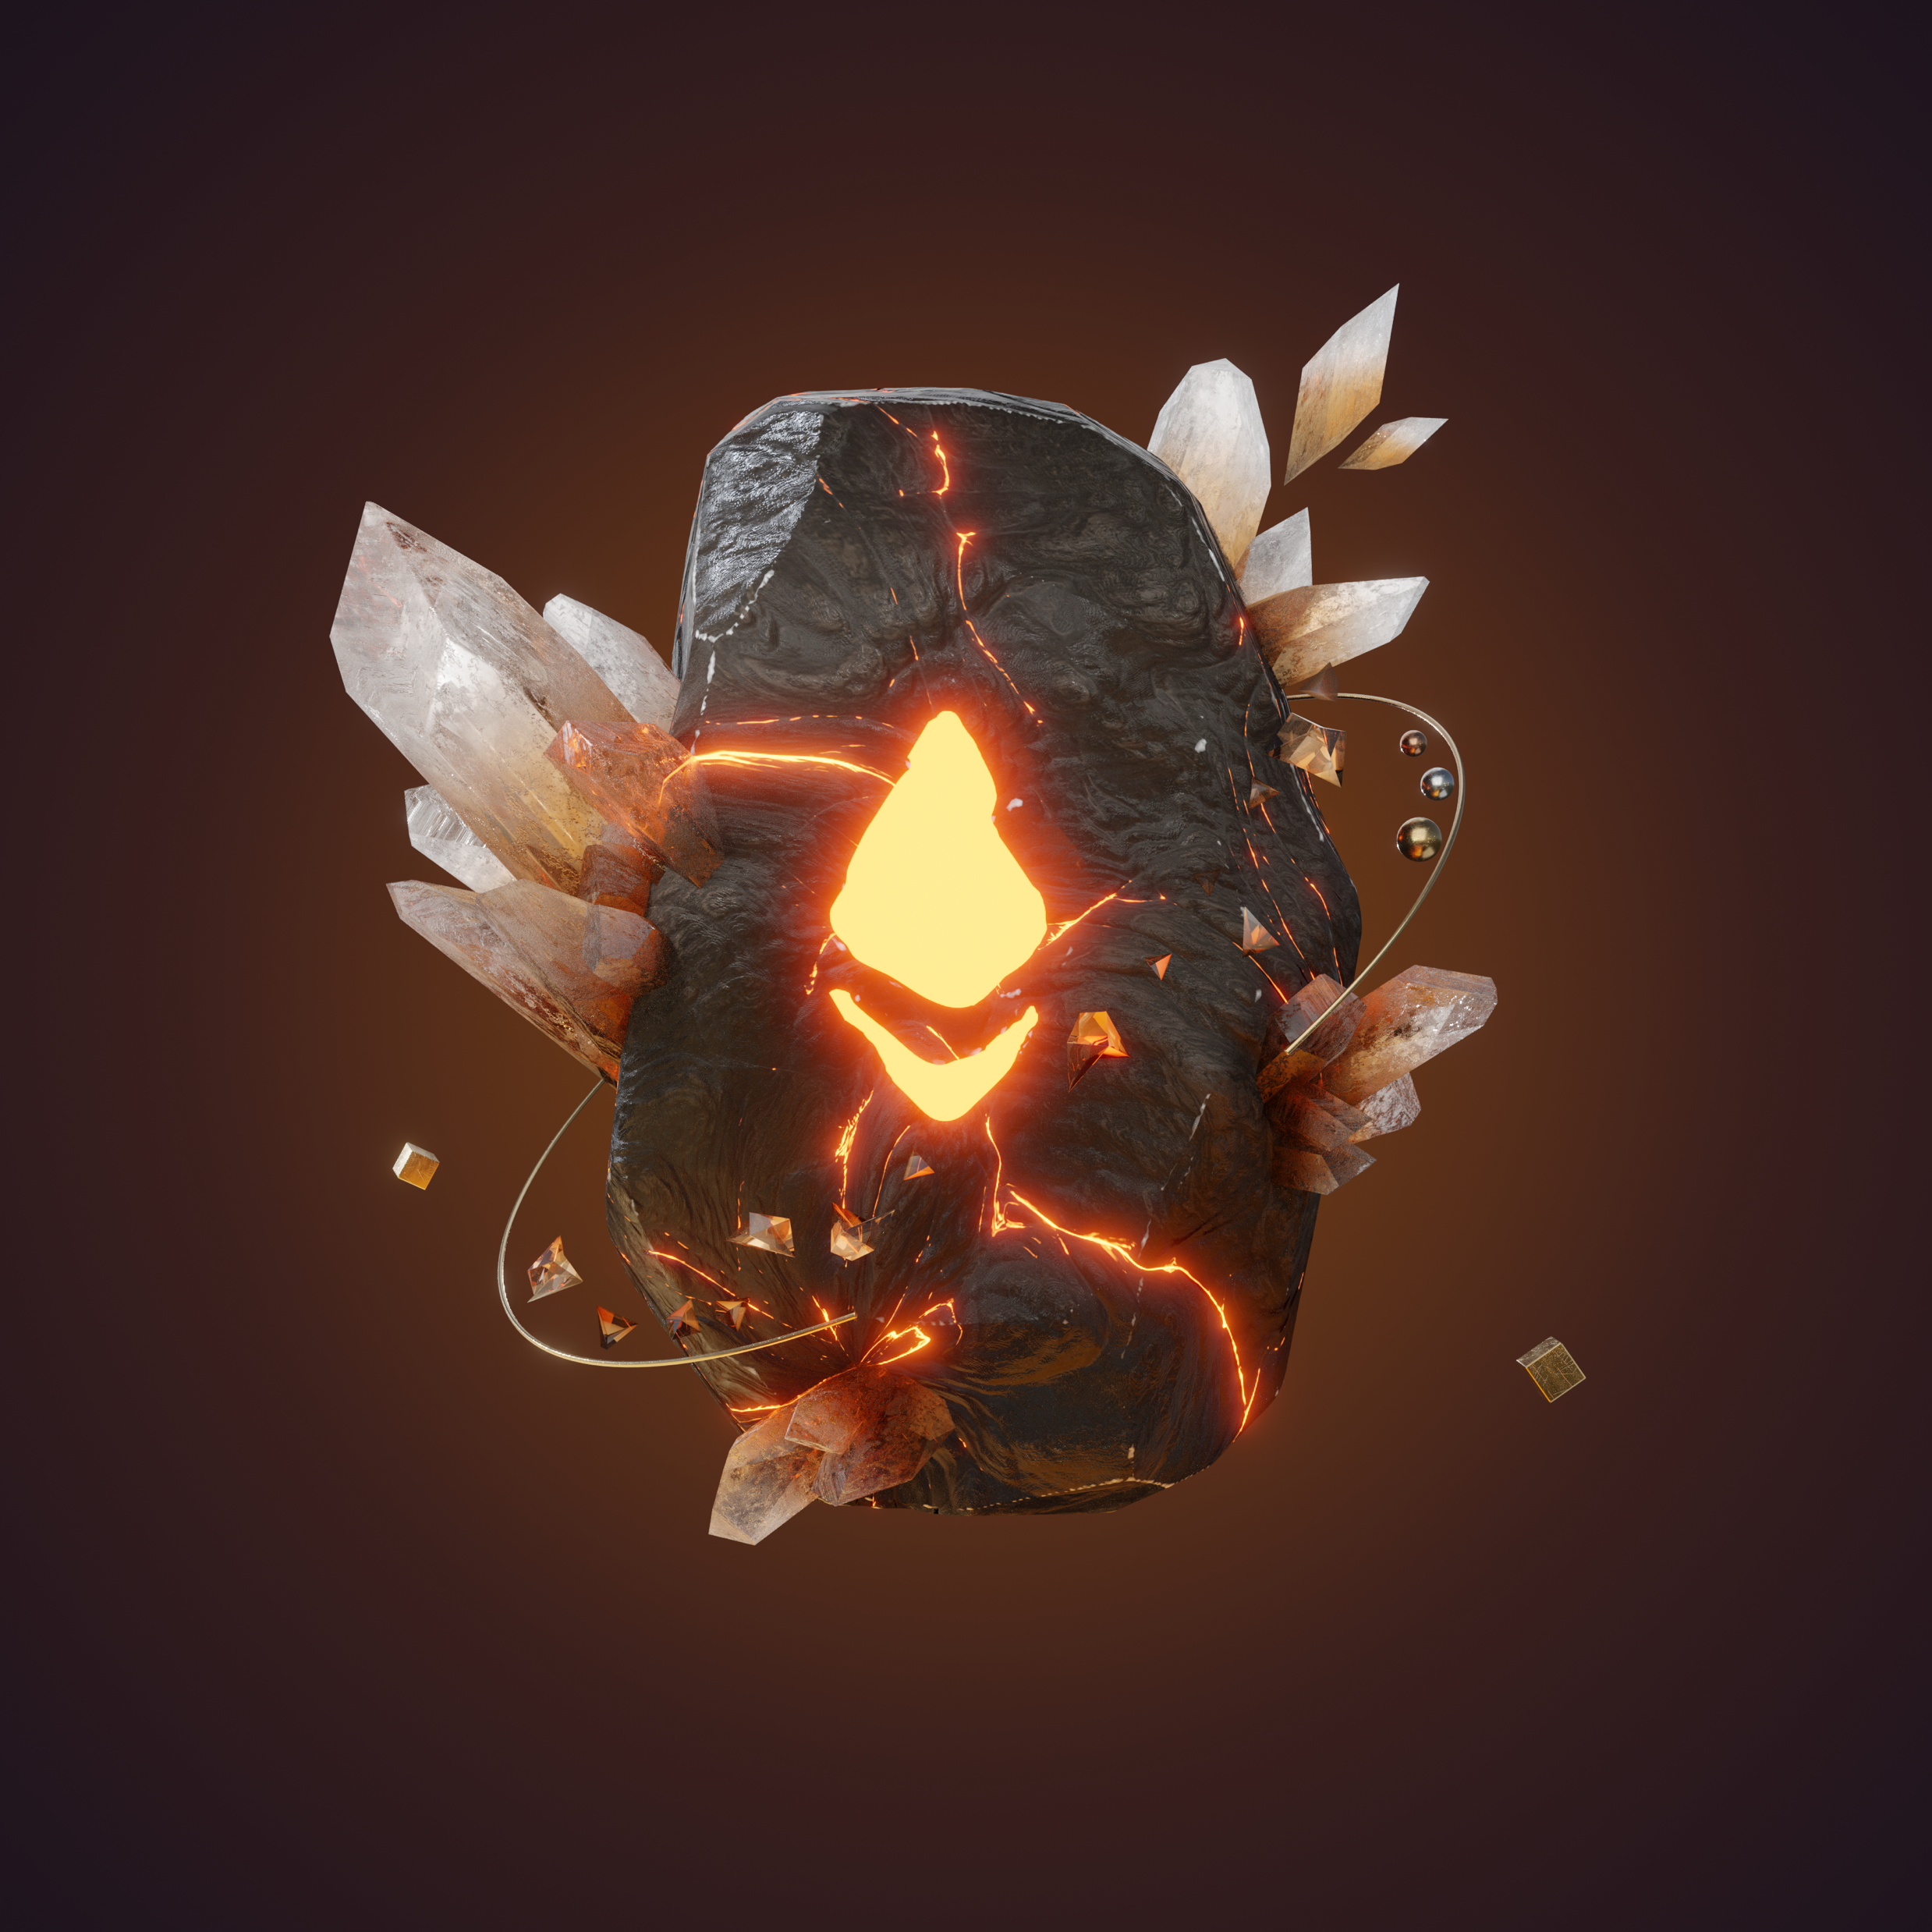
MetaRocks

Slide 10
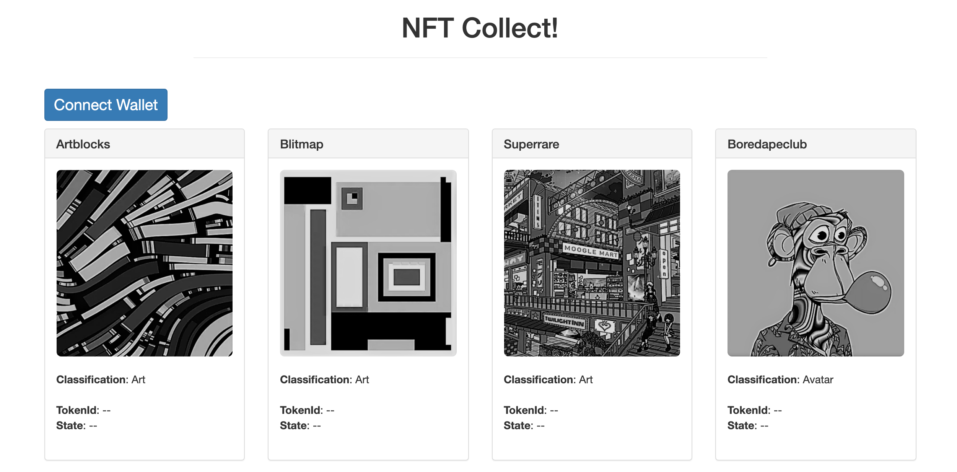
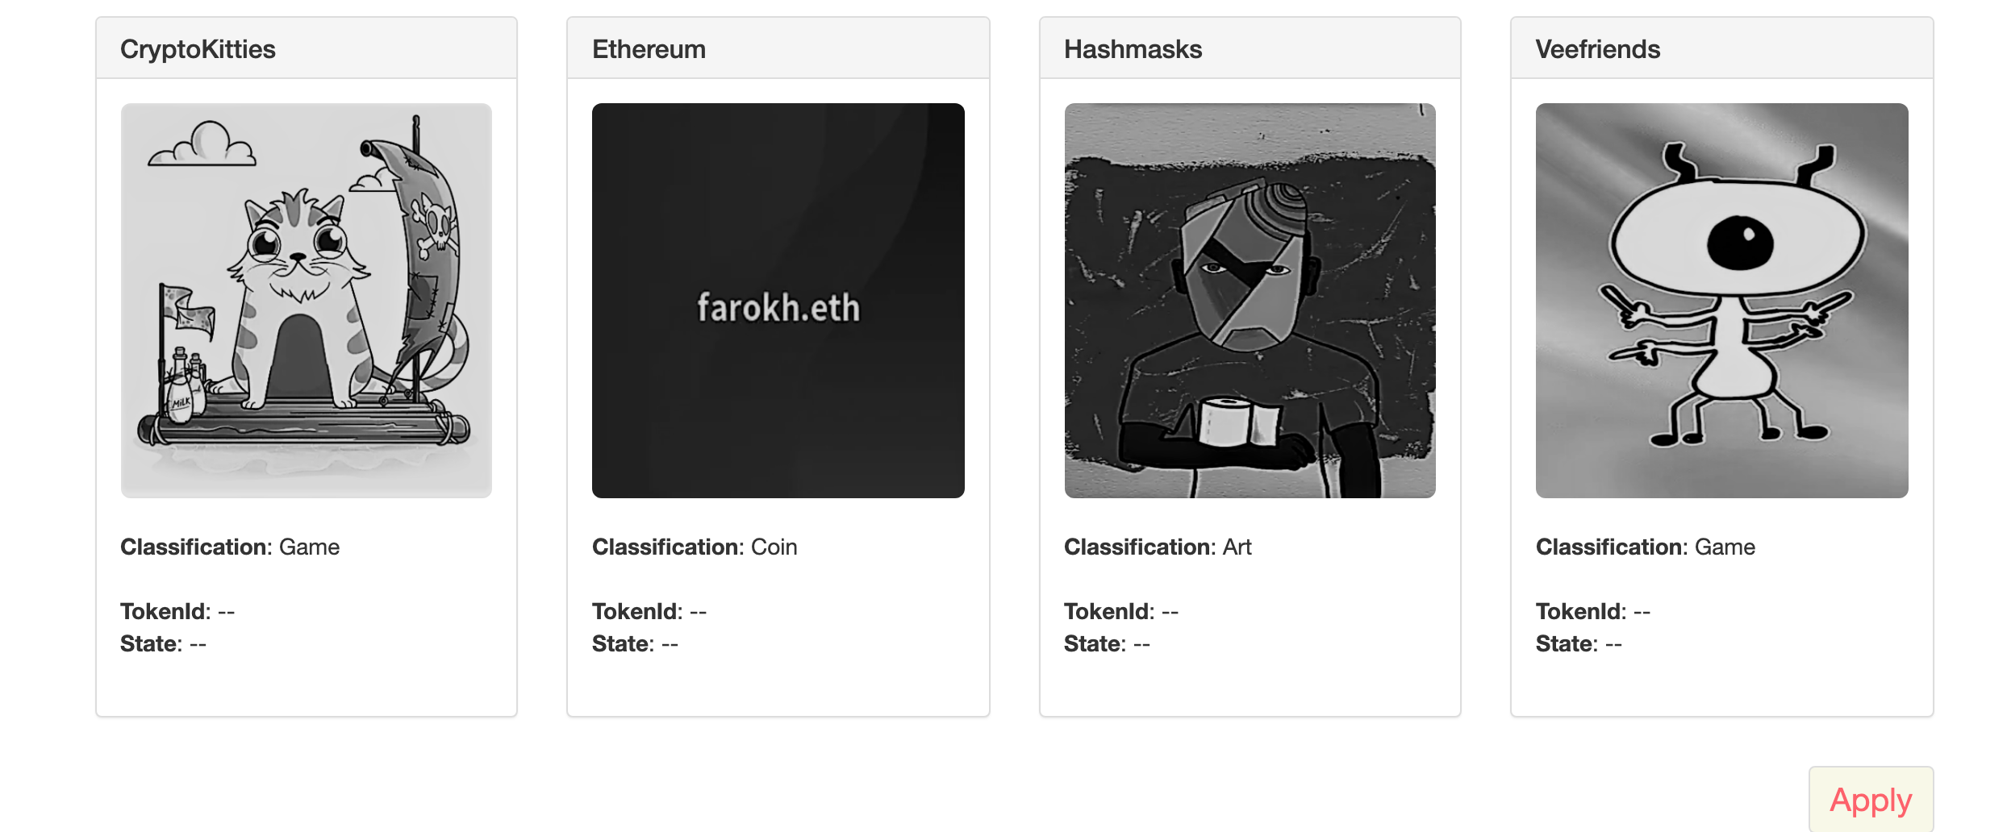

Slide 11
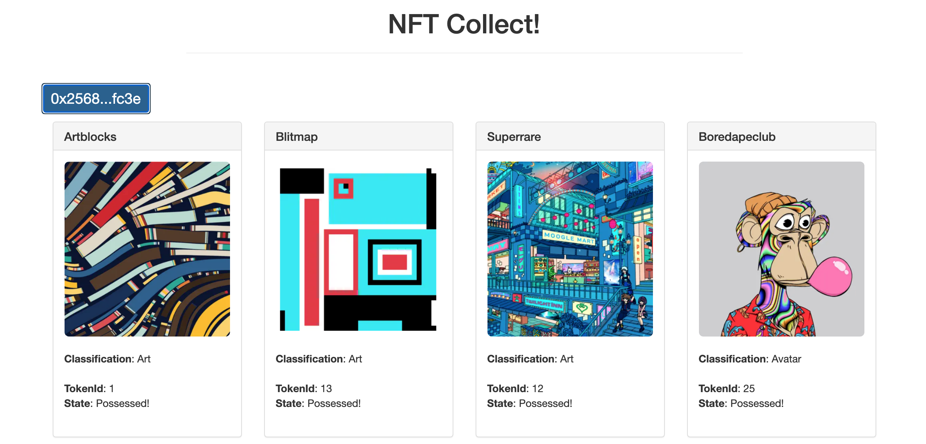
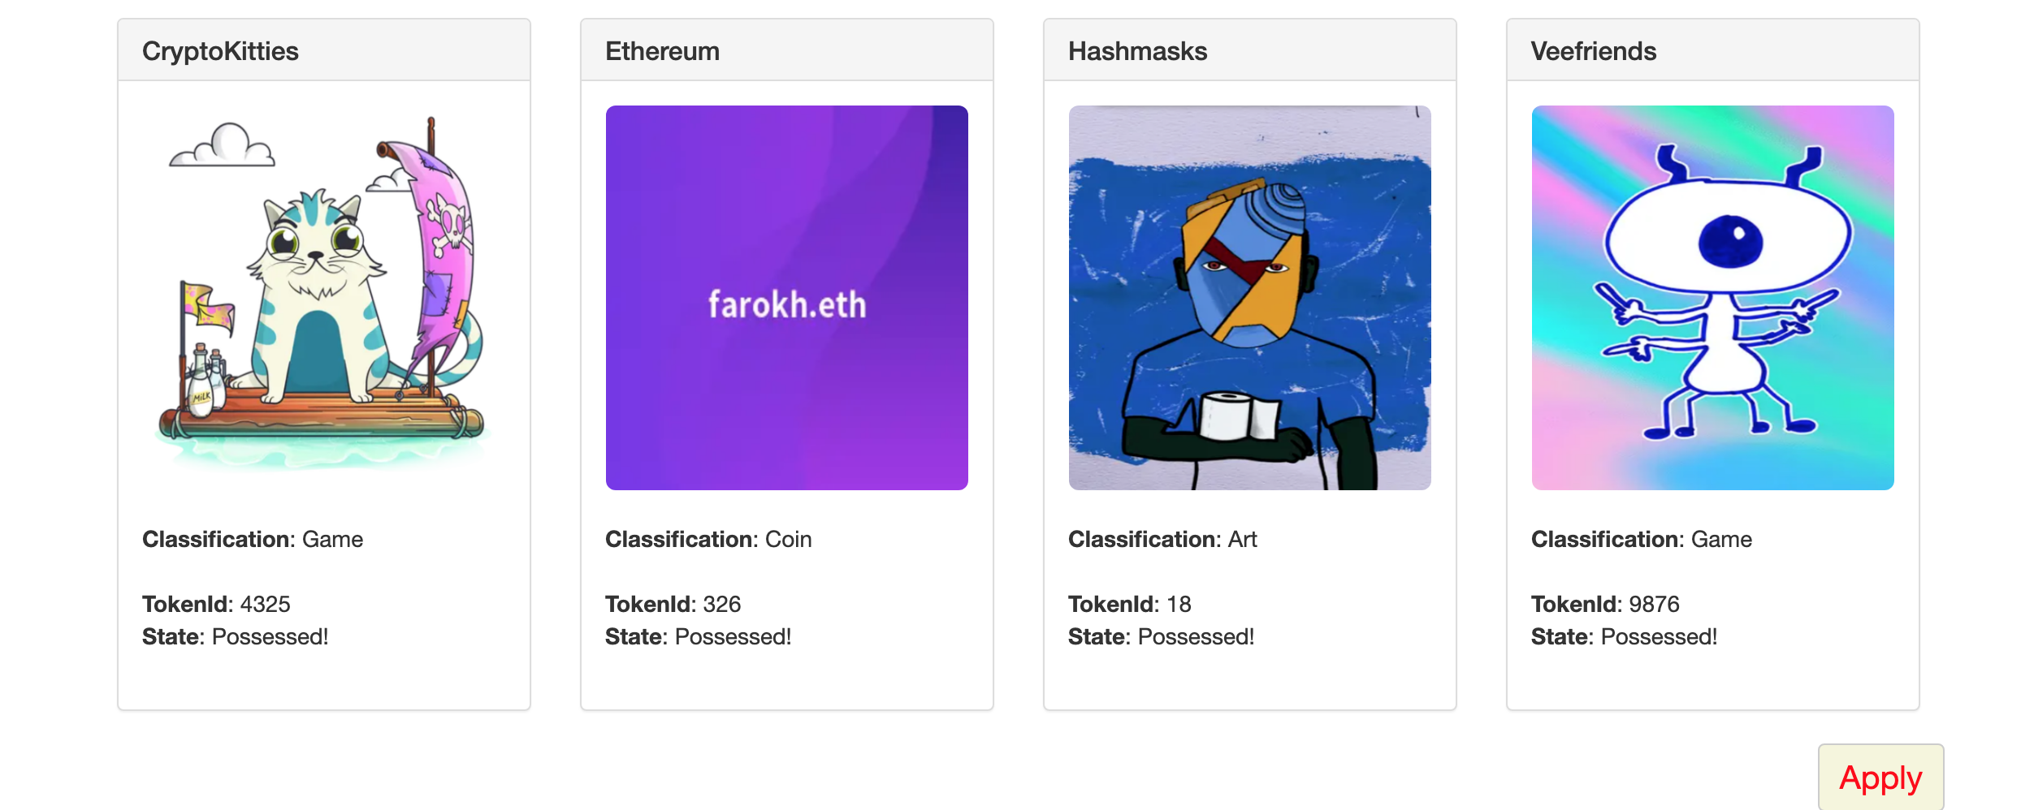

Slide 12
Your Medal

Slide 13
Part
Expection
Too many interesting projects wait to be added.

Slide 14
Loan
Cooperation between items
Qualification
Special ID application
Others

Slide 15
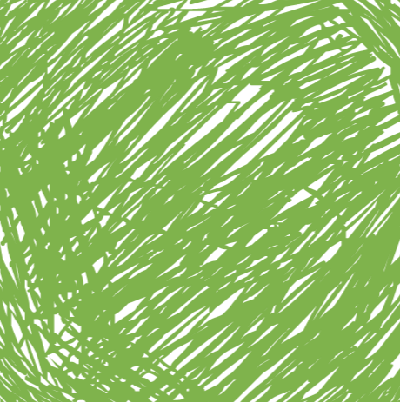
Diversity
Our plantform supports various items, such as cryptopunks …
Compatible
Our plantform can Integrate seemingly unrelated projects together and make them as a whole.
Friendly
Our plantform is easily-usable, users and project owners can get started quickly.
To Make Metaverse More Wonderful. To Make NFT More Valuable!

Slide 16
THANK YOU!
汇报人：NFTChallenge
时间：2021-10-4

